Slide 1
HTML & CSS
Review & Lab 2

Slide 2
Common XHTML Tags
BLOCK LEVEL (by default)
<h2>headings: h1-h6</h2>
<p>paragraph</p>
<div>text </div>
Lists:
<ul><li>bullets</li><ul>
<ol><li>numbered</li></ul>
These are all you require for Lab2's <body>. See the "Simple XHTML Reference" in the LMS as well. (...and use the web!)
INLINE (by default)
<span>text</span>
<em>emphasis</em>
<strong>strong</strong>
<a href="uri">text</a>
ATTRIBUTES ID and CLASS
<div id="somename">…</div>
<div class="another">…</div>
<p class="repeatMe">…</p>
<span class="meToo">…</span>

Slide 3
XHTML Document
<!DOCTYPE html PUBLIC "-//W3C//DTD XHTML 1.0 Strict//EN" "http://www.w3.org/TR/xhtml1/DTD/xhtml1-strict.dtd">
<html xmlns="http://www.w3.org/1999/xhtml" xml:lang="en" lang="en">
<head>
<meta http-equiv="Content-Type" content="text/html; charset=UTF-8"/>
<title>a title for the document</title>
</head>
<body>
<div id="content">
<h1>Heading for this Page</h1>
<div class="someBox">
<p>First paragraph in "someBox" with <a href="uri">a link</a>.</p>
</div>
</div>
</body>
</html>

Slide 4
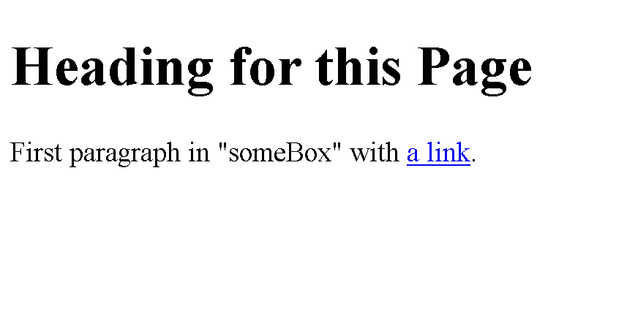
XHTML Document, Rendered:

Slide 5
IDs and Classes
An "id" is a unique identifier for an element
<div id="footer"></div>
A "class" is a non-unique identifier for an element
<div class="rightCallOut"></div>

Slide 6
Some CSS Properties
width
margin
padding
border
color
background-color
font-family
font-size
font-variant
display
float
clear
white-space
text-align (tip: this only works inside blocks)
list-style
It is possible to accomplish Lab2 using only these -- but you don't have to use them all or be limited to them either.

Slide 7
HTML/CSS Example
#footer { border-top: 1px solid black; padding: 0.5em 1em 1em 1em; color: #333; background-color: #eee; } #footer a:hover { font-weight: bold; font-style: italic; } em { color: red; }
<div id="footer">
<a href="somepage.html">
This link will be <em>styled</em>
on a mouse hover
</a>
</div>

Slide 8
Selectors
HTML like this | might be selected like this
ID selectors
<div id="header"></div> | #header {}
<h2 id="mainTitle"></h2> | h2#mainTitle {}
class selectors
<p class="green"></p> | .green {}
<li class="selected"></li> | li.selected {}
element selectors
<p class="green"></p> | p {}
<h1></h1> | h1 {}
<p><strong>hi</strong></p> | p strong {}
See http://www.w3.org/TR/CSS2/selector.html

Slide 9
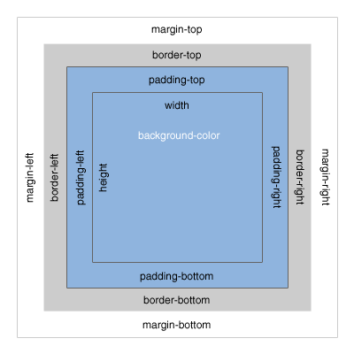
CSS Box Model
[Untitled graphic of the CSS Box Model, Bitmap]. Retrieved September 10 from http://www.mandalatv.net/itp/drivebys/css/

Slide 10
Floating Elements
An element may be floated left or right (or not at all, which is default)
.pullQuote { float: right; clear: right; width: 100px; }
"A pull quote is a good example."

Slide 11
paragraph
float right
paragraph

Slide 12
Where to go for help...
Search the web! (A search engine is your friend.)
Try W3Schools:
Particularly for its references
http://www.w3schools.com/
Try other sites too
View page source! Look at CSS files.
The web is open – learn from others

Slide 13
XHTML Code Style
Correct XHTML example:
<!-- output news block --> <div id="news"> <h3>Latest News</h3> <ul> <li>Item 1</li> <li>Item 2</li> </ul> </div>

Slide 14
CSS Code Style
Correct CSS example:
ul#header li { float: left; width: 100px; background-color: #F0EEE5; color: black; }
/* highlight the selected tab */ ul#header li.selected { background-color: #000; color: white; }

Slide 15
Some Tips
Think of layout in terms of boxes on a page (we'll do some examples of this together as part of Lab2)
Floated elements typically require explicit widths to work as you expect them to work.
How to center a block relative to the page?
Use margin:
#someBlock { margin: 1em auto 2em auto; } /*or maybe just "margin: auto" */

Slide 16
Lab 2 - HTML & CSS
Learn by doing:
You are to create a resume
I’ve provided you a starting HTML template
We will work through some of this together in class
Feel free to experiment and be creative (but show us that you can create something similar to the example resume)
This will be due before midnight one week from today. See the lab in the LMS for more specifics.

Slide 17
Layout Blocking
browser window
(body)
top-level block
header of some kind?
more blocks inside another block

